Slide 1
Vocabulary Study for “Racism” articles

Slide 2
innuendo
(n.) an allusive or oblique remark or hint, typically a suggestive or disparaging one.

Slide 3
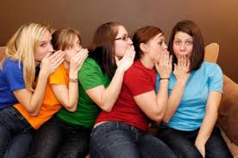
She is always making sly innuendos about me. She doesn’t even know me!

Slide 4
warp
(n.) the threads on a loom over and under which other threads are passed to make cloth.

Slide 5
woof
(n.) the threads that run across a piece of fabric

Slide 6
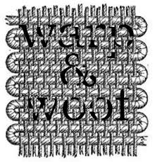
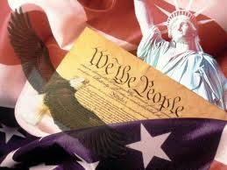
“The Constitution and the Declaration of Independence are the warp and woof of the American nation.”

Slide 7
rhetoric
(n. ) the art of effective or persuasive speaking or writing, especially the use of figures of speech and other compositional techniques.

Slide 8
The Student Body presidential candidate convinced me to vote for him with his amazing rhetoric.

Slide 9
jocular
(adj.) fond of or characterized by joking; humorous or playful.

Slide 10
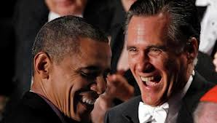
The president was in a jocular mood when he beat his opponent

Slide 11
slur
(n.) an insinuation or allegation about someone that is likely to insult them or damage their reputation.

Slide 12
Public racial slurs can get celebrities in big trouble.

Slide 13
grievous
(adj.) very severe or serious.

Slide 14
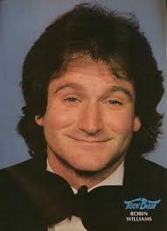
Robyn Williams’ death was a grievous blow to his fans.

Slide 15
bohunk
(n.) an immigrant from central or southeastern Europe, especially a laborer. A rough or uncivilized person.

Slide 16
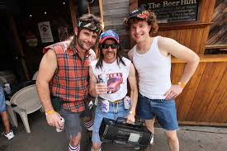
Calling someone a bohunk can be considered a disparaging remark, or a slur.

