Slide 1
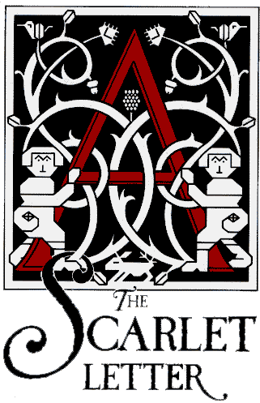
By Nathaniel Hawthorne

Slide 2
Teachers Note
The following presentation is an introduction to Nathaniel Hawthorne’s novel, The Scarlet Letter.
Notes are included in the notes section to help the instructor.
PowerPoint may be modified; material may be deleted or included.
Material taken from numerous websites and work cited is included at the end of the presentation.
This presentation is intended as an introduction to the novel and help generate student interest prior to reading.

Slide 3
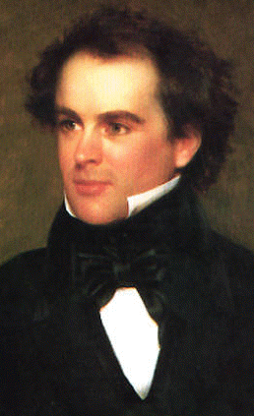
Background
Nathaniel Hawthorne was born in Salem, Massachusetts, in 1804.
The Scarlet Letter is set in the mid-1600s in Boston, which had been founded only about two decades earlier.
In 1630 hundreds of newly arrived Puritans established a number of settlements in Massachusetts.
Notes:
Raised by a widowed mother, Hawthorne attended Bowdoin College in Maine, where he met two people who were to have great impact upon his life: Henry Wadsworth Long-fellow, who would later become a famous poet, and Franklin Pierce, who would later become president of the United States.

Slide 4
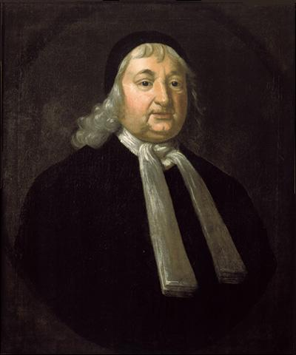
Descendent of a Salem Judge
Fascinated by Puritans
His family descended from the earliest settlers of the Massachusetts Bay Colony.
Throughout his life, Hawthorne was both fascinated and disturbed by his kinship with John Hathorne.
One of his ancestors was John Hathorne (Hawthorne added the “w” to his name when he began to write),
He was one of the judges at the 1692 Salem witch trials.
Notes:
The Puritan setting also enables him to portray the human soul under extreme pressures. Hester, Dimmesdale, and Chillingworth, while unquestionably part of the Puritan society in which they live, also reflect universal experiences. Hawthorne speaks specifically to American issues, but he circumvents the aesthetic and thematic limitations that might accompany such a focus. His universality and his dramatic flair have ensured his place in the literary canon.

Slide 5
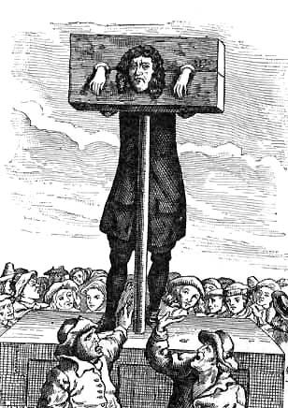
Puritan Past
Religious Reformers
The majority of The Scarlet Letter takes place in America’s Puritan past.
This religious sect was known for its intolerance of dissenting ideas and lifestyles.
In The Scarlet Letter, Hawthorne uses the repressive, authoritarian Puritan society as an analogue for humankind in general.
Notes:
The Puritans were a group of religious reformers who arrived in Massachusetts in the 1630s under the leadership of John Winthrop (whose death is recounted in the novel).

Slide 6
Did You Know?
Laws in colonial Massachusetts covered everything from swearing to excessive decoration on women’s caps to murder.
Whipping, branding, and other forms of public humiliation were relatively common practices in the colonies.
Notes:
Hester Prynne’s punishment of having to wear a scarlet letter was mild by Puritan standards.

Slide 7
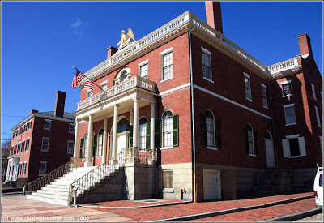
How the novel came to be.
The Scarlet Letter begins with a long description about how the book came to be written.
The narrator, nameless, was a surveyor in the custom house in Salem, Massachusetts.
He discovers some documents and a manuscript bundled with the Scarlet gold-embroidered patch of cloth in the shape of an “A.”
Notes:
The manuscript, the work of a past surveyor, detailed events that occurred some two hundred years before the narrator’s time. When the narrator lost his customs post, he decided to write a fictional account of the events recorded in the manuscript. The Scarlet Letter is the final product.

Slide 8
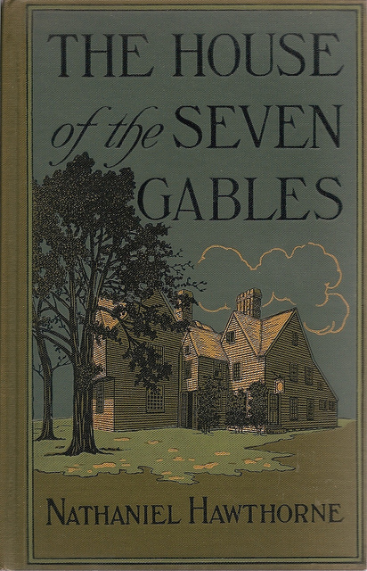
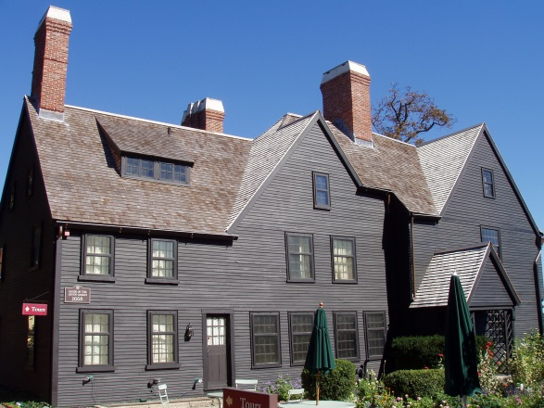
Published in 1850
More novels followed…
Hawthorne published The Scarlet Letter to an enthusiastic reading audience.
His other major novels include The House of the Seven Gables (1851), The Blithedale Romance (1852), and The Marble Faun (1860).

Slide 9
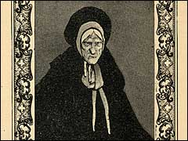
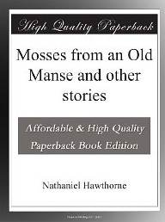
Mosses from an Old Manse
Stories about early America
American Shakespeare
This collection of short stories earned Hawthorne the attention of the literary establishment.
This collection displayed a stylistic freshness American literature had yet to display.
Herman Melville, among others, hailed Hawthorne as the “American Shakespeare.”
Notes:
Mosses from an Old Manse earned Hawthorne the attention of the literary establishment because America was trying to establish a cultural independence to complement its political independence, and Hawthorne’s collection of stories displayed both a stylistic freshness and an interest in American subject matter.

Slide 10
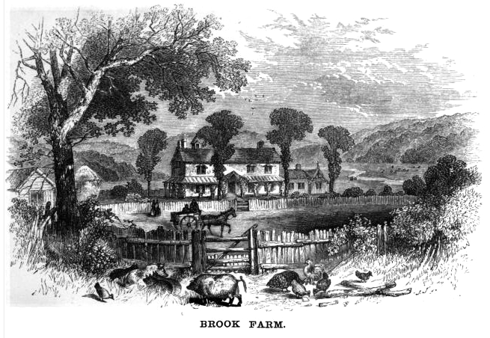
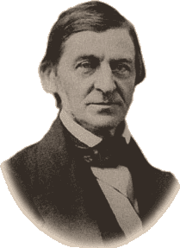
Later in life he adopted Transcendentalism
Hawthorne left his life for Brook Farm
Hawthorne developed a professional relationship with fellow writers, Ralph Waldo Emerson and Margaret Fuller. He began to adopt transcendentalist principles.
Transcendentalism was a religious and philosophical movement in the early 19th century that dedicated itself to the belief that divinity could be found anywhere, particularly in the natural world.
Notes:
His growing relationship with the intellectual circle that included Ralph Waldo Emerson and Margaret Fuller led him to abandon his customs post for the utopian experiment at Brook Farm, a commune designed to promote economic self-sufficiency and transcendentalist principles.

Slide 11
characters

Slide 12
Avoiding Stereotype
One element of The Scarlet Letter that made this novel unique for its time was its lack of stereotyping.
For example, a stereotyped villain is evil and heartless. The hero or heroine pitted against that villain is often portrayed as compassionate, strong, or good-looking. Most heroes have an unusually well-developed sense of right and wrong.
Notes:
Unlike other writers of his time, Hawthorne avoided stereotypical characters and shallow characterization. He fully developed his characters by examining what made them human.

Slide 13
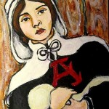
Hester Prynne
Hester is the book’s protagonist and the wearer of the scarlet letter that gives the book its title.
The letter, a patch of fabric in the shape of an “A,” signifies that Hester is an “adulterer.”
As a young woman, Hester married an elderly scholar, Chillingworth, who sent her ahead to America to live but never followed her.
Notes:
Though society tries to demean and disgrace her, Hawthorne emphasizes that Hester never looked more attractive as when she first emerged from prison wearing the scarlet letter.

Slide 14
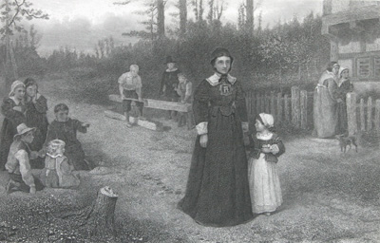
Hester Prynne
While waiting for him, she had an affair with a Puritan minister named Dimmesdale, after which she gave birth to Pearl.
Notes:
Hester plays many roles in The Scarlet Letter: devoted mother, abandoned lover, estranged wife, religious dissenter, feminist, and outcast, to name just a few.

Slide 15
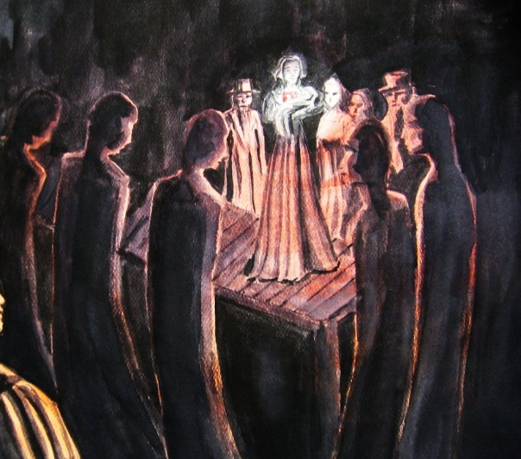
Hester Prynne
Hester is not just a rebel, she's a glorified rebel, and Hawthorne uses her to criticize the Puritan's strict society.
He portrays Hester fondly, as a woman of strength, independence, and kindness, who stands up to the judgments and constraints of her society.
Notes:
She equals both her husband and her lover in her intelligence and thoughtfulness. Her alienation puts her in the position to make acute observations about her community, particularly about its treatment of women.

Slide 16
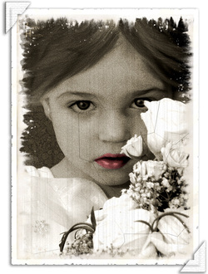
Pearl
Pearl - Hester’s illegitimate daughter Pearl is a young girl with a moody, mischievous spirit and an ability to perceive things that others do not.
For example, she quickly figures out he truth about her mother and Dimmesdale.
The townspeople say that she barely seems human and spread rumors that her unknown father is actually the Devil.
She is wise far beyond her years.
Notes:
Hester's daughter. Pearl is characterized as a living version of the scarlet letter.
She constantly causes her mother and Dimmesdale torment and anguish throughout the novel
with her ability to at once state the truth and deny it when it is most necessary.
Like the letter, Pearl is the public consequence of Hester's very private sin.
Him himYet also like the scarlet letter, Pearl becomes Hester's source of strength.

Slide 17
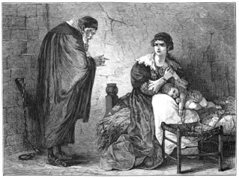
Roger Chillingworth
“Roger Chillingworth” is actually Hester’s husband in disguise.
He is much older than she is and had sent her to America while he settled his affairs in Europe.
He is captured by Native Americans, then arrives in Boston to find Hester and her illegitimate child being displayed on the scaffold.
He wants revenge, and decides to stay in Boston to find out who disgraced his wife.

Slide 18
Roger Chillingworth
He is a scholar and uses his knowledge to disguise himself as a doctor.
Chillingworth is self-absorbed and both physically and psychologically monstrous.
His single-minded pursuit of retribution reveals him to be the most malevolent character in the novel.
Chillingworth is a forbidding presence. Even his name reflects his haunting, ice-cold aura.

Slide 19
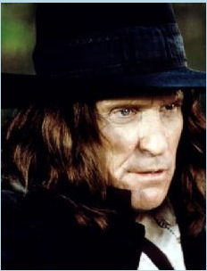
Roger Chillingworth
Chillingworth is an older man whom she married for reasons other than love.
Dimmesdale is a beloved reverend with whom she had an affair out of love and irrepressible desire.
Chillingworth punishes Hester and Dimmesdale covertly by tormenting Dimmesdale almost to the point of killing him.
Meanwhile, he hypocritically makes Hester swear not to reveal his true identity as her husband in order to avoid the humiliation of being associated with their scandalous affair.
Roger Chillingworth
Rev. Dimmesdale
Notes:
In the end, by tormenting Dimmesdale, Chillingworth transforms himself into a sick and twisted man, a kind of fiend.

Slide 20
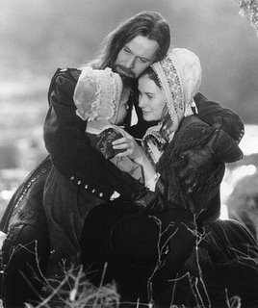
Rev. Arthur Dimmesdale
Dimmesdale is a young man who achieved fame in England as a theologian and then emigrated to America.
In a moment of weakness, he and Hester became lovers.
Although he will not confess it publicly, he is the father of her child.
Notes:
Shy, retiring, and well loved and respected by his public, Dimmesdale is too frightened and selfish to reveal his sin and bear the burden of punishment with Hester. Yet at the same time, Dimmesdale secretly punishes himself for his sin by fasting and whipping himself.

Slide 21
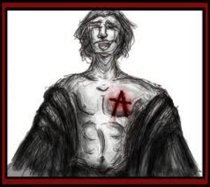
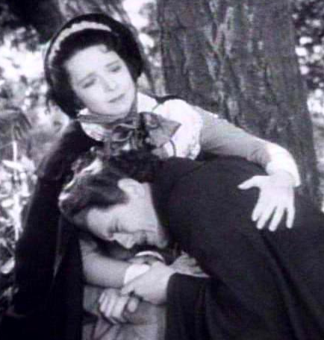
Rev. Arthur Dimmesdale
He deals with his guilt by tormenting himself physically and psychologically, developing a heart condition as a result.
Dimmesdale is an intelligent and emotional man, and his sermons are thus masterpieces of eloquence and persuasiveness.
His commitments to his congregation are in constant conflict with his feelings of sinfulness and need to confess.
Notes:
Ultimately the suffering and punishment he endures, though self-inflicted, proves far worse than Hester's or Pearl's, suggesting that betrayal and selfishness are greater sins than adultery. Dimmesdale's guilty conscience overwhelms him like a plague, robbing him of his health and preventing him from raising his daughter. His eventual confession comes too late, and he dies a victim of his own pride.

Slide 22
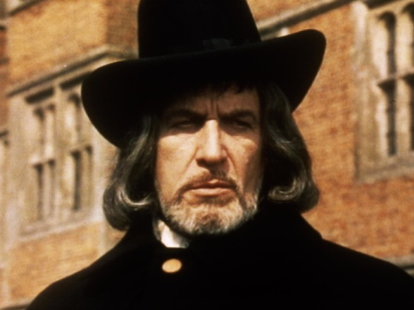
Gov. Bellingham
Governor Bellingham - Governor Bellingham is a wealthy, elderly gentleman who spends much of his time consulting with the other town fathers.
Despite his role as governor of a fledgling American society, he very much resembles a traditional English aristocrat.
Bellingham sticks to the rules, but he is easily swayed by Dimmesdale’s eloquence.
He remains blind to the misbehaviors taking place in his own house: his sister, Mistress Hibbins, is a witch.
Notes:
Governor Bellingham punishes any behavior that does not fit with the strict Puritan rules of behavior. This makes him a hard-hearted hypocrite. For instance, even while employing Hester to do fancy needlepoint for him, he tries to take Pearl from her, arguing that as an adulterer she's an unfit mother. Later, he convicts and executes his own sister of practicing witchcraft.

Slide 23
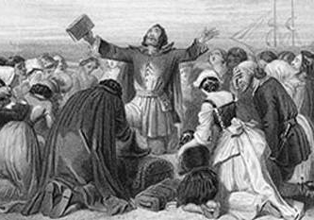
Colonial Government
The government of Massachusetts was not a democracy. Rather, it was a theocracy—a state governed by its church.
The General Court had decided, early on, that only church members could become freemen of Massachusetts.
The ministers held great power and influence over all church members.
Ministers’ interpretation of the Bible and their “management” of moral codes and conduct applied to all residents of the colony, whether a lowly freeman or the governor himself.

Slide 24
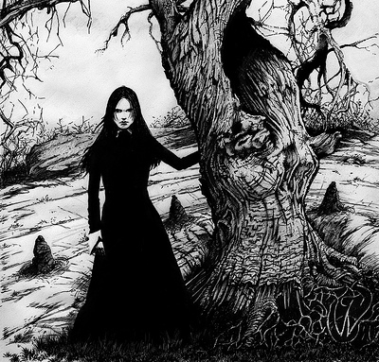
Mistress Hibbins
Mistress Hibbins - Mistress Hibbins is a widow who lives with her brother, Governor Bellingham, in a luxurious mansion.
She is commonly known to be a witch who ventures into the forest at night to ride with the “Black Man.”
Notes:
Her appearances at public occasions remind the reader of the hypocrisy and hidden evil in Puritan society. She is executed for practicing witchcraft about a year after Dimmesdale dies. Her death shows how merciless Puritan society had become in the name of piety and propriety: the Governor would even order the execution of his own sister.

Slide 25
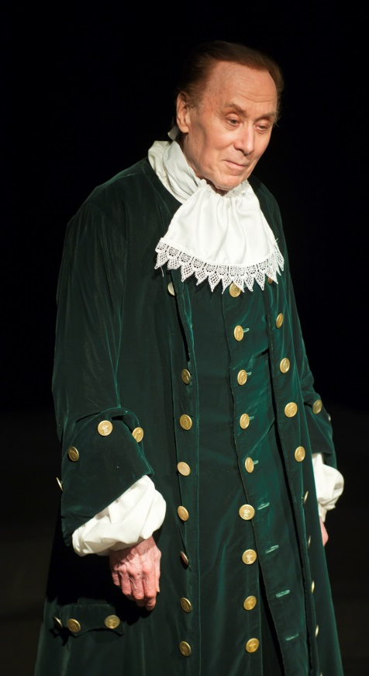
Rev. Mr. John Wilson
Reverend Mr. John Wilson - Boston’s elder clergyman, Reverend Wilson is scholarly yet grandfatherly.
He is a stereotypical Puritan father figure to Rev. Dimsdale.
Like Governor Bellingham, Wilson follows the community’s rules strictly but can be swayed by Dimmesdale’s eloquence.
Unlike Dimmesdale, Wilson preaches hellfire and damnation and advocates harsh punishment of sinners.

Slide 26
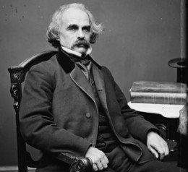
Narrator
Narrator - The unnamed narrator works as the surveyor of the Salem Custom-House some two hundred years after the novel’s events take place.
He discovers an old manuscript in the building’s attic that tells the story of Hester Prynne.
The narrator is a rather high-strung man, whose Puritan ancestry makes him feel guilty about his writing career.
Notes:
He writes because he is interested in American history and because he believes that America needs to better understand its religious and moral heritage. He describes the novel as a tale of "human frailty and sorrow" and encourages the reader to heed its moral. Throughout the novel, the narrator favors Hester against the Puritans who persecute her. His writing often reads as if he's pained to have to tell such a sad story that involves the downfall of innocent victims at the hands of an oppressive society.

Slide 27
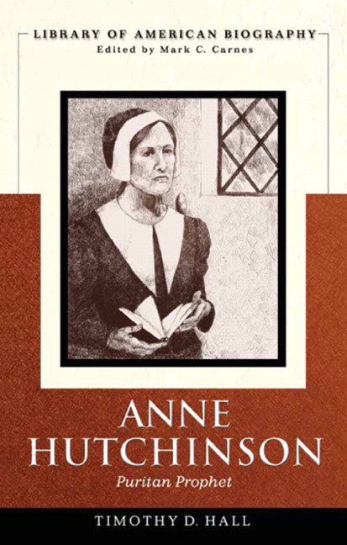
Anne Hutchinson
She was a real historical figure.
Gov. Winthrop had Hutchinson tried for questioning the authority of the ministers.
Hutchinson was banished from the Puritan colony.
Hutchinson had supporters, and her group of admirers later included Nathaniel Hawthorne, who refers to her as the “sainted Ann Hutchinson” in Chapter 1 of The Scarlet Letter.
She opposed the Puritan concept of morality, which she considered to be unnecessarily legalistic. She also opposed the authority of the Boston clergy.
Notes:
Six years later Hutchinson and all but one of her children were killed by Native Americans on Long Island Sound.

Slide 28
Major themes

Slide 29
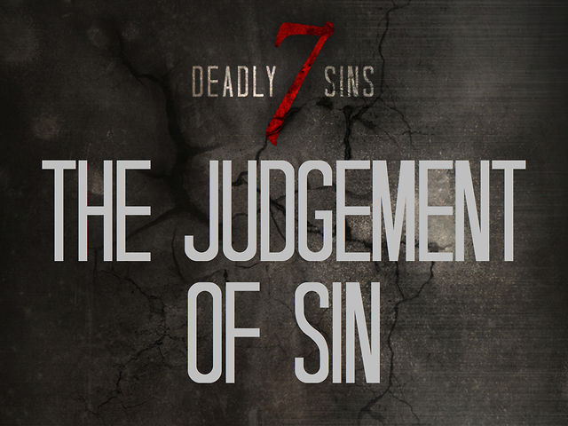
Sin and Judgment
Hawthorne's novel consistently calls into question the notion of sin and what is necessary for redemption.
Is Hester's initial crime a sin? Or is the sin first marrying Chillingworth without thinking it through?
What is Chillingworth's sin? Essentially abandoning his wife for so long upon their marriage, or failing to forgive her once he knew of the crime?
Is Dimmesdale's sin his adultery or his hypocritical failure to change his sermon themes after the fact?
Notes:
Or are all of these things sins of different degrees?
The Puritans believed people were born sinners. Puritan preachers depicted each human life as suspended by a string over the fiery pit of hell. As a result, the Puritans maintained strict watch over themselves and their fellow townspeople, and sins such as adultery were punishable by death. Hester is spared execution only because the Puritans of Boston decided it would benefit the community to transform her into a "living sermon against sin." But just as Hester turns the physical scarlet letter that she is forced to wear into a beautifully embroidered object, through the force of her spirit she transforms the letter's symbolic meaning from shame to strength.

Slide 30
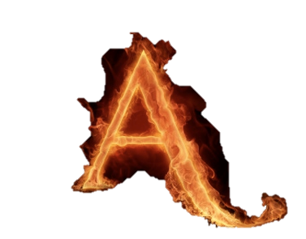
The Scarlet Letter
The scarlet letter is symbolic in a number of different ways.
One of the most important ways is that the characters choose to wear the letter.
Hester adds fancy embroidery to the letter as a point of pride.
Dimmesdale, however, as the town minister, wears his own scarlet A burned upon his flesh, since it is the community's rage he fears the most.
Notes:
Thus we see the difference between a woman who has made peace with the crime, publicly confesses, and endures the suffering the community imposes, and a man who imposes his own punishment because he cannot bear to reveal the crime to the community.
Hawthorne read about this choice in an actual case in 1844, recorded it in his journal, and thus The Scarlet Letter was born as Hester Prynne's story.

Slide 31
Punishment versus Forgiveness
Chillingworth seems to be the character that embodies moral judgment.
Since Rev. Dimmesdale seems to be corrupted, Chillingworth takes it upon himself to inflict punishment on Dimmesdale for what he perceives is a crime that cannot be forgiven.
He is surprisingly forgiving of Hester's crime. We sense that he understands why she would forsake him. After all, he is deformed, he is older, he has not been nearby, while she is beautiful and passionate.
In Dimmesdale, he sees the vigor and passion which Hester desires and which he himself does not possess and he cannot forgive Dimmesdale.
Notes:
Like a leech, he's out to suck Dimmesdale of his life force, not just to punish the minister for the crime of fornicating with his wife, but also to symbolically appropriate Dimmesdale's virility. And as the novel continues, Chillingworth seems to grow stronger while Dimmesdale seems to weaken. That pattern continues until Dimmesdale dies in an act of defiance, his public demonstration of guilt, which essentially leaves Chillingworth stripped bare of his power to punish or forgive.

Slide 32
Public Guilt vs. Private Guilt
Perhaps the foremost purpose of The Scarlet Letter is to illustrate the difference between shaming someone in public and allowing him or her to suffer the consequences of an unjust act privately.
Does adultery really have no impact upon the lives of others? If not, it should not be seen as a crime against the village?
Notes:
According to the legal statutes at the time and the prevailing sentiment of keeping in accordance with a strict interpretation of the Bible, adultery was a capital sin that required the execution of both adulterer and adulteress--or at the very least, severe public corporal punishment. Indeed, even if the husband wanted to keep his wife alive after she committed adultery, the law insisted that she would have to die for it.

Slide 33
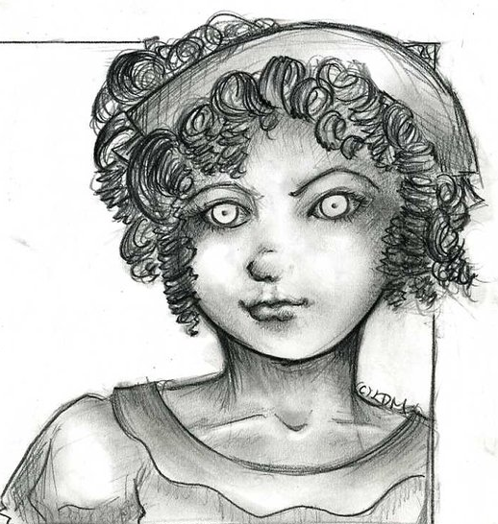
Civilization vs. Wilderness
Pearl embodies the theme of wilderness over civilization.
She is a kind of embodiment of the scarlet letter. Pearl is innocence, a passionate innocence.
So long as Dimmesdale is alive, Pearl seems to be a magnet that attracts Hester and Dimmesdale, almost demanding their reconciliation or some sort of energetic reconciliation.
But as soon as Dimmesdale dies, Pearl seems to lose her vigor and becomes a normal girl, able to marry and assimilate into society.
Notes:
The implication is thus that Pearl truly was a child of lust or love, a product of activity outside the boundaries imposed by strict Puritan society. Once the flame of love is extinguished, she can properly assimilate.

Slide 34
Nature
In The Scarlet Letter, nature stands in contrast to Puritanism.
Where Puritanism is merciless and rigid, nature is forgiving and flexible.
This contrast is made clear from the very first page, when the narrator contrasts the "black flower" of the prison that punishes sin with the red rose bush that he imagines forgives those sentenced to die.
Notes:
The theme of nature continues with the forest outside Boston, which is described as an "unchristianized, lawless region." In the dark forest, wild, passionate, and persecuted people like Hester, Pearl, Mistress Hibbins, and the Indians can escape from the strict, repressive morality of Puritan society. The forest, which provides a measure of comfort and protection that exists nowhere in society, is also the only place where Hester can reunite with Dimmesdale.

Slide 35
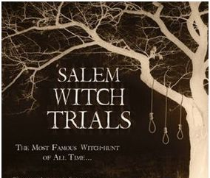
The Occult
Most people associate the town of Salem, Massachusetts with the infamous "Salem Witch Trials."
Set in and around Boston, The Scarlet Letter also deals with the specter of witchcraft and the occult.
But the novel treats witchcraft and the occult sympathetically.
By associating Pearl with other outcasts like Mistress Hibbins, Hawthorne suggests that witches were created by, and victims of, the excessively strict Puritan society.
Notes:
Puritan society created the witches by being so intolerant that people became interested in witchcraft as a way of expressing natural human feelings that Puritanism repressed. Puritanism then viewed witches as a threat to its repressive society and therefore sentenced all witches, like Mistress Hibbins, to death.

Slide 36
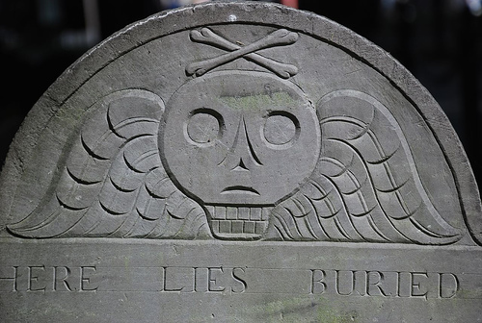
Red and Black
Red symbolizes the glow of Hester's passion.
Black represents the devil and sin. Chillingworth, for instance, refers to their shared fate as a "black flower."
The inscription on the tombstone Hester and Dimmesdale share says "On a field, sable, the letter A, gules," which means "On a black background, the scarlet letter burns."

Slide 37
Plot overview

Slide 38
Novel Overview
The novel is set in seventeenth-century Boston, a city governed by strict Puritan law.
The story begins as Hester Prynne, the novel's protagonist, is led out of a prison carrying an infant, named Pearl, in her arms. A bright red "A" is embroidered on her chest.
A crowd waits expectantly as Hester is forced to climb up a scaffold to endure public shame for her sin.
While on the scaffold, Hester is terrified to recognize her estranged husband, Chillingworth, in the crowd. He recognizes her too, and is shocked.

Slide 39
Novel Overview Cont.
Chillingworth pretends not to know Hester, and learns her story from a man in the crowd:
Chillingworth predicts the unknown man will be found out, but when the beloved local Reverend Arthur Dimmesdale commands Hester to reveal the man's name, she refuses and is sent back to her prison cell.
Chillingworth poses as a doctor to get inside the prison to speak with Hester, and there forces her to promise never to reveal that he's her husband. Read the novel to find out the rest of the intriguing story….
After two years she fell into sin, committing the adultery that resulted in her baby and the scarlet "A" on her breast.

Slide 40
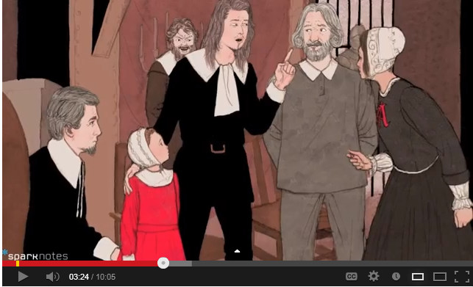
Click here for The Scarlet Letter video from Sparknotes.
Notes:
http://www.youtube.com/watch?v=uen92KjCSsg

Slide 41
Information paraphrased and directly quoted from the following websites:
http://www.sparknotes.com/lit/scarlet/
http://www.glencoe.com/sec/literature/litlibrary/pdf/scarlet_letter.pdf
http://www.litcharts.com/lit/the-scarlet-letter/characters

Slide 42
Here is an extra slide template and case you want to add anything more.

