Slide 1
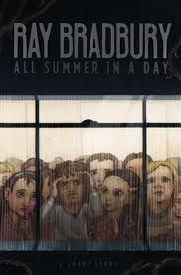
All Summer in a Day
By: Ray Bradbury

Slide 2
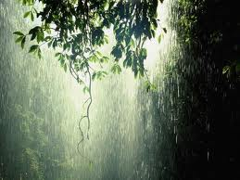
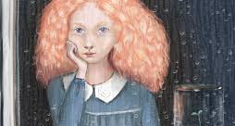
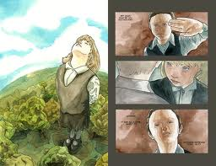

Slide 3
Literary Analysis - Setting
The setting of a story is the time and place of the action. In this example, the details in italics help establish the story’s setting:
As night fell, the hungry raccoons roamed the forest for food.
In some stories, setting is just a backdrop. The same story events could take place in a completely different setting
In other stories, setting is very important. It develops a specific atmosphere or mood in the story. The setting may even relate directly to the story’s central conflict or problem.

Slide 4
Background
Venus: “All Summer in a Day” is set on Venus, the second planet from the sun. Today, we know that Venus has a surface temperature of almost 900 degrees Fahrenheit. In 1950, when Ray Bradbury wrote this story, some scientists believed that the clouds of Venus concealed a watery world. That information may have led Bradbury to create a setting of soggy jungles and constant rain.

Slide 5
Venus
Venus is roughly equal in size to Earth. For this reason, it is sometimes called “Earth’s Twin.” Its climate and atmosphere, however, are unlike Earth’s, and it is unable to sustain life. The atmosphere is primarily carbon dioxide – the gas human beings exhale – and the atmospheric pressure is about ninety times greater than that of Earth. The clouds are around Venus that scientists one thought to be rain clouds are actually clouds of sulfuric acid.

Slide 6
Ray Bradbury
As a boy, Ray Bradbury loved magicians, circuses, and science-fiction stories. He began writing his own imaginative tales and by the age of seventeen had his first story published in a magazine called Imagination!
In 1950, Bradbury won fame for his book of science-fiction stories called The Martian Chronicles. One story describes how a group of Earthlings struggle on the rainy world of Venus. Bradbury began to wonder how a child might react to the sun’s brief appearance on Venus. Four years later, he answered his own question by writing “All Summer in a Day.”

Slide 7
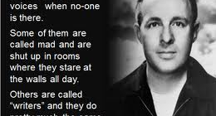
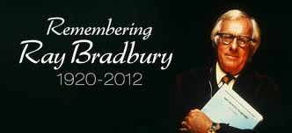

Slide 8
Fast Facts about Ray Bradbury
Many of Bradbury’s stories have been adapted for the television series The Twilight Zone
He served as a consultant to the Disney Company, the New York World’s Fair, and a number of architects.

Slide 9
Vocabulary
Slackening – easing; becoming less active
Vital – extremely important or necessary
Tumultuously – Noisily and violent
Resilient – Springing back into shape

