Slide 1
Vocabulary Study for “how to live a 100 years”

Slide 2
superannuated
(adj.) old and therefore no longer very effective or useful

Slide 3
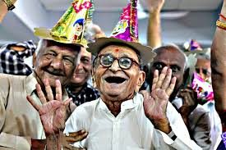
I think its safe to assume that we'll both be rather superannuated by the time our number is up.

Slide 4
emulate
(v ) to try to be like (someone or something you admire)

Slide 5
I try to emulate my uncle; he is awesome and truly a role model.

Slide 6
salubrious
(adj.) making good health possible or likely

Slide 7
The air of Allonby is highly salubrious and conducive to longevity, as the bills of mortality show.

Slide 8
extroverted
(adj. ) a friendly person who likes being with and talking to other people : an outgoing person

Slide 9
My math teacher is really extroverted; he gets along with everyone.

Slide 10
genomic
(adj. ) of or relating to a genome (one haploid set of chromosomes with the genes they contain)

Slide 11
Our work in microbial genomics is aimed at understanding genome organization and evolution.

Slide 12
pathology
(n.) the study of diseases and of the changes that they cause

Slide 13
A pathologist studies the cells removed during a biopsy to test for signs of cancer.

Slide 14
longevity
(n.) length of life

Slide 15
epigenetic
(adj.) relating to, being, or involving changes in gene function that do not involve changes in DNA sequence

Slide 16
Epigenetic mechanisms, not directly related to genetic factors, are also plausible culprits for the occurrence of dyslexia

Slide 17
cognitive
(n.) of, relating to, or involving conscious mental activities (thinking, studying, remembering)

Slide 18
The tumor is still growing, which means there is still a chance at cognitive deterioration.

