Slide 1
Vocabulary Study for “cutting away the verbal fat adds muscle to your writing”

Slide 2
verbosity
(n) the quality of using more words than needed; wordiness.

Slide 3
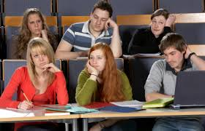
The verbosity of my English professor is annoying. I can’t understand half of what he says! He just sounds pompous to me.

Slide 4
girth
(n ) the measurement around the middle of something, especially a person's waist.

Slide 5
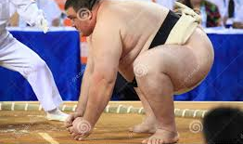
The girth of a sumo wrestler is impressive

Slide 6
mirth
(n.) gladness or gaiety as shown by or accompanied with laughter.

Slide 7
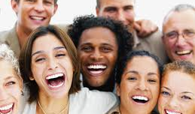
That party we went to last night was filled with enjoyment and mirth.

Slide 8
jargon
(n. ) special words or expressions that are used by a particular profession or group and are difficult for others to understand.

Slide 9
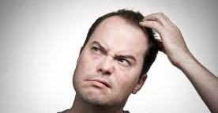
Often people do not make a will because they are confused by the lengthy legal jargon.

Slide 10
enshroud
(v. ) envelop completely and hide from view

Slide 11
Rain and snow are copious, and dense fogs enshroud the coast in summer.

Slide 12
enlightenment
(n.) the action of enlightening or the state of being enlightened. To be aware, with full understanding.

Slide 13
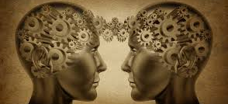
Although the man considered himself well-educated, he decided to spend a year in on a deserted island in an attempt to gain further enlightenment.

