Slide 1
More Literary Devices

Slide 2
symbol
A symbol is anything that represents another thing

Slide 3
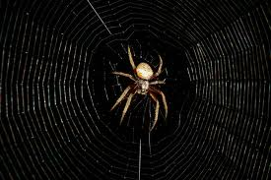
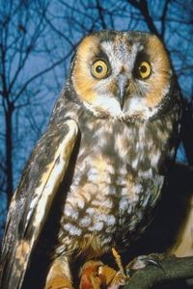
In literature, an object may represent something related to the theme. For example, in a love story, a web may signify entanglement.
A symbol may also be part of other literary devices such as foreshadowing

Slide 4
motif
While a symbol might occur once in literature to signify an idea or an emotion, a motif can be an element or idea that repeats throughout that piece of literature. A motif could be expressed by a collection of related symbols.
Motifs can also be recurring structures or literary devices that reveal the theme.

Slide 5
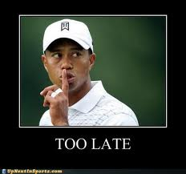
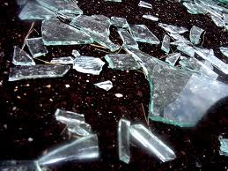
For example, the motif of fragmentation (of a family, for instance) could come from several symbols that appear in a book: shattered glass an unfaithful spouse

Slide 6
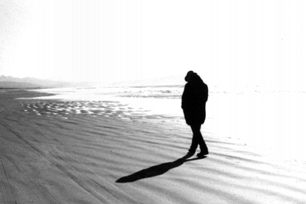
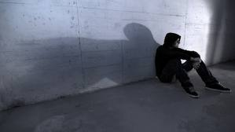
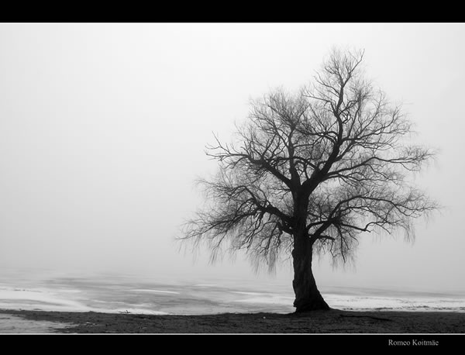
A theme related to loneliness and lost love may be revealed by imagery such as a desert, an empty house, blank walls, a single barren tree. These recurring images are motifs.

Slide 7
A motif is generally related to theme and/or mood. It is a recurring element that has symbolic significance.
It is a recurring image, idea or pattern that helps reveal the theme of the text.

Slide 8
Allusion
An allusion is a figure of speech whereby the author refers to a subject matter such as a place, event, or literary work by way of a passing reference. It is up to the reader to make a connection to the subject being mentioned.

Slide 9
Examples of Allusions in TKAM
You don’t have to touch her, all you have to do is make her afraid..I'll get you in on the Ladies' Law...(p. 250).
Ladies' Law: From the Criminal Code of Alabama, Vol. III, 1907: "Any person who enters into, or goes sufficiently near to the dwelling house of another, and, in the presence or hearing of the family of the occupant thereof, or any member of his family, or any person who, in the presence or hearing of any girl or woman, uses abusive, insulting or obscene language must, on conviction, be fined not more than two hundred dollars, and may also be imprisoned in the county jail, or sentenced to hard labour for the county for not more than six months."

Slide 10
“First, people had removed from their store windows and automotives the stickers that’s said NRA-WE DO OUR PART. I asked Atticus why, and he said it was because the National Recovery Act was dead. I asked him who killed it: he said nine old men. (p.251)
National Recovery Act: better known as the National Recovery Administration or the NRA. The NRA was a series of programs set up to help the nation, especially the nation's businesses, recover from the effects of the Great Depression. It was ruled unconstitutional by the Supreme Court in 1935.
Nine old men: the members of the Supreme Court. The Supreme Court declared the NRA unconstitutional in 1935.

Slide 11
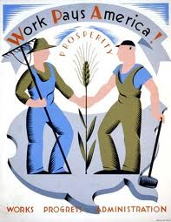
“.….he was the only man I ever heard of who was fired from the WPA for laziness.”
(p. 248)
WPA: During the Great Depression, when millions of Americans were out of work, the government instituted the Works Progress Administration (WPA) and employed over eight million people

Slide 12
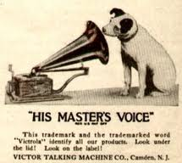
"Miss Frutti, not about to miss anything, employed an ear trumpet so enormous that Jem declared it was a loudspeaker from one of those dog Victrolas (p. 251).“
Dog Victrolas: a reference to the advertising symbol of RCA/Victor; a dog, known as "Nipper," looking into the horn of a gramophone or Victrola.

Slide 13
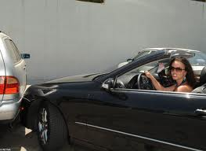
Irony
There are three types of irony:
Verbal irony:
An attitude or expression that is opposite of what is said
Example:
A character gets into a car crash and is congratulated for his “great driving skills”

Slide 14
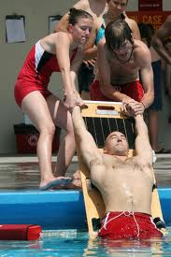
Situational irony:
When a situation or event ends the opposite of what is expected
Example:
When a lifeguard is saved from drowning

Slide 15
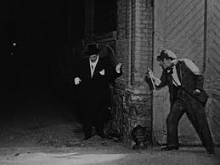
Dramatic irony:
When the audience knows something that the characters do not.
Example:
Horror movies are notorious for using dramatic irony. The audience knows that the murderer is behind the door or around the corner even when the victim does not.

Slide 16
Examples of Irony in TKAM
“Over here we don’t believe in persecuting anybody. Persecution comes from people who are prejudiced.” (p.245)
What kind of irony is this?

