Slide 1
Literary Devices

Slide 2
Literary devices are elements that an author uses to make his writing more descriptive, poetic, or plain interesting. These devices and the way an author uses them are part of the author’s style
The definition of style is the distinctive way in which a writer uses language, from how he/she puts sentences together to his/her choice of vocabulary and use of literary devices.

Slide 3
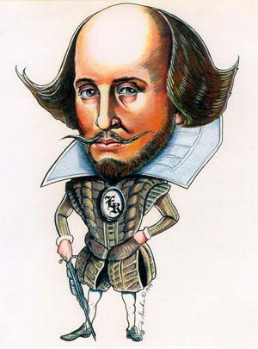
Example of style:
Shakespeare wrote in a style with a specific meter and rhythm called iambic pentameter. Readers sometimes have difficulty understanding his unique style of writing

Slide 4
Figurative Language
Expressing ideas indirectly; language used in a special way to create a special effect made up of words and phrases which don’t mean what they first appear to mean.
Figurative language includes metaphor, simile, personification and hyperbole

Slide 5
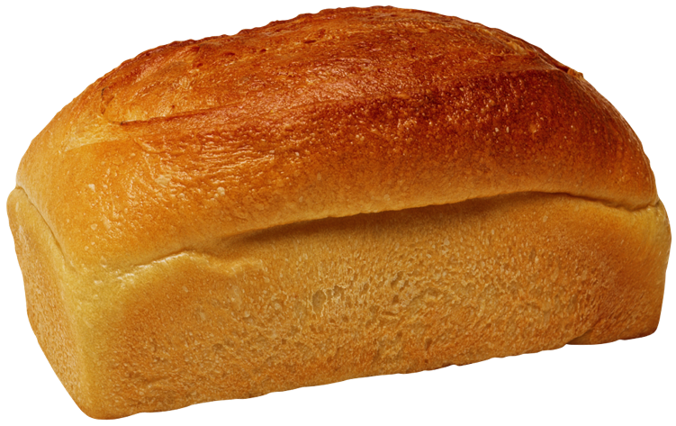
Metaphor
Definition: A comparison between two things that are basically dissimilar in which one thing becomes another.
Example: “My mother’s hair is the warm smell of bread after you bake it.”

Slide 6
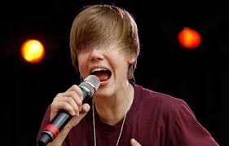
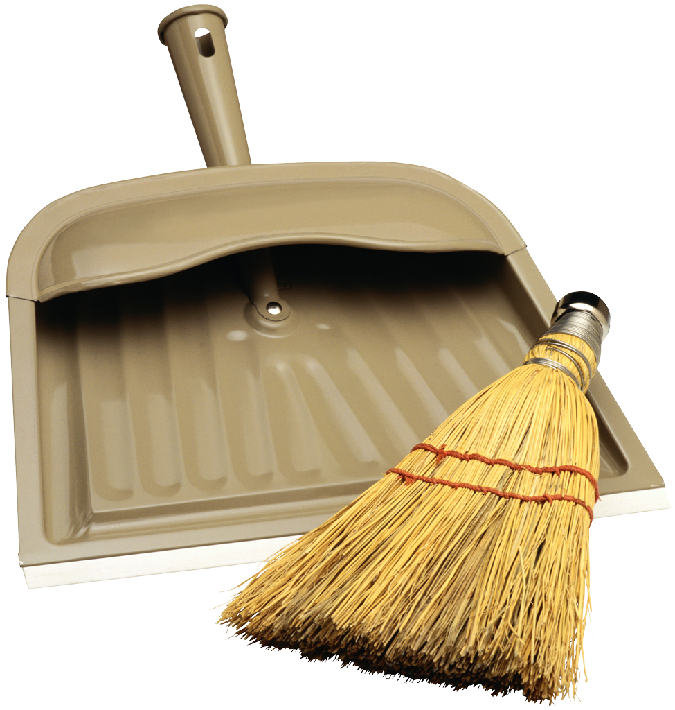
Simile
Definition: Comparison of two things that are basically dissimilar in using “like” or “as” to make the comparison
Example: “Justin Bieber’s hair is like a broom.”

Slide 7
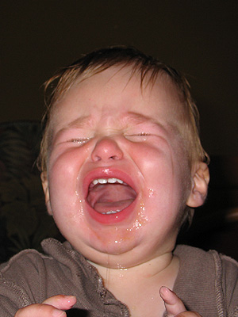
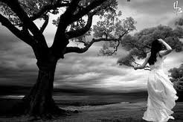
Personification
Definition: The act of giving human qualities to something that is not human.
Example:
The wind wailed in rising crescendo

Slide 8
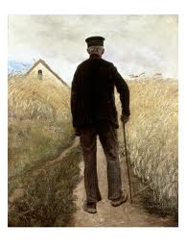
Hyperbole
A ridiculous exaggeration that is not intended to be taken literally.
Example:
He was older than the hills
Hyperbole
A ridiculous exaggeration that is not intended to be taken literally.

Slide 9
symbol
A symbol is anything in a piece of literature that represents something else.

Slide 10
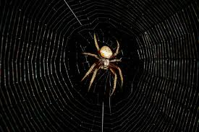
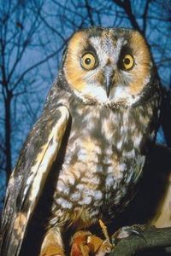
In literature, an object may represent something related to the theme. For example, in a love story, a web may signify entanglement.
A symbol may also be part of other literary devices such as foreshadowing

Slide 11
motif
While a symbol might occur once in literature to signify an idea or an emotion, a motif can be an element or idea that repeats throughout that piece of literature. A motif could be expressed by a collection of related symbols.
Motifs can also be recurring structures or literary devices that reveal the theme.

Slide 12
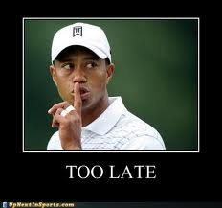
For example, the motif of fragmentation (of a family, for instance) could come from several symbols that appear in a book: shattered glass an unfaithful spouse

Slide 13
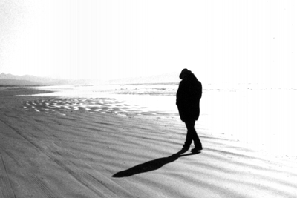
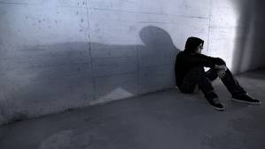
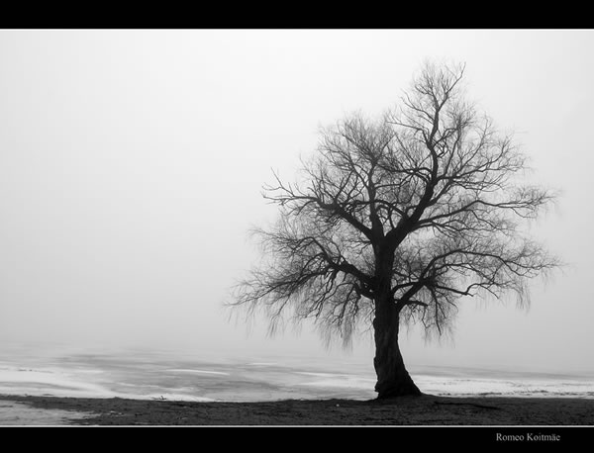
A theme related to loneliness and lost love may be revealed by imagery such as a desert, an empty house, blank walls, a single barren tree. These recurring images are motifs.

Slide 14
A motif is generally related to theme and/or mood. It is a recurring element that has symbolic significance.
It is a recurring image, idea or pattern that helps reveal the theme of the text.

Slide 15
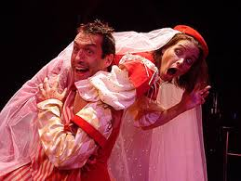
Theme
Definition: The base topic or focus of the literary piece. The underlying message about human nature that is universal.
Example: in Taming of the Shrew one of the themes is that in relationships, partners tend to adapt to each other’s personalities.

Slide 16
Tone
The writer’s attitude towards the subject that influences the expression of his ideas.
Example:
In Taming of the Shrew, the tone is mostly humorous and satirical.

Slide 17
Mood
The mental and emotional disposition of the author towards the subject, which in turn lends a particular character or atmosphere to the work. It’s how the author makes the reader feel.

Slide 18
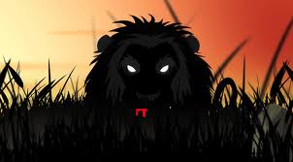
Example:
In Ray Bradbury’s “The Veldt,” the author creates a mood of uneasiness and oppressiveness through the use of figurative language and imagery.

Slide 19
Imagery
Words and phrases that create “mental images” for the reader. Imagery helps the reader to visualize and therein more realistically experience the author’s writings

Slide 20
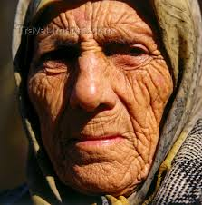
Example of imagery:
“Her face was the color of a dirty pillowcase, and the corners of her mouth glistened with wet, which inched like a glacier down the deep grooves enclosing her chin.”
To Kill a Mockingbird, 1960

Slide 21
Foreshadowing
The presentation in a work of literature of hints and clues that tip the reader off as to what is to come later in the work.

Slide 22
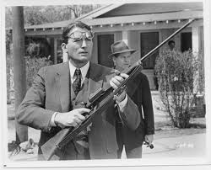
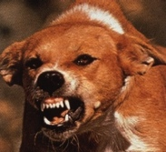
Example of foreshadowing:
In To Kill a Mockingbird the appearance of the “mad dog” foreshadows the “madness” that would overcome the small town of Mayberry.

Slide 23
Allusion
An allusion is a figure of speech whereby the author refers to a subject matter such as a place, event, or literary work by way of a passing reference. It is up to the reader to make a connection to the subject being mentioned.

Slide 24
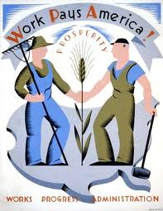
Example of allusion:
“.….he was the only man I ever heard of who was fired from the WPA for laziness.”
(To Kill a Mockingbird p. 248)
WPA: During the Great Depression, when millions of Americans were out of work, the government instituted the Works Progress Administration (WPA) and employed over eight million people

Slide 25
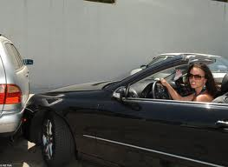
Irony
There are three types of irony:
Verbal irony:
An attitude or expression that is opposite of what is said
Example:
A character gets into a car crash and is congratulated for his “great driving skills”

Slide 26
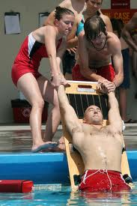
Situational irony:
When a situation or event ends the opposite of what is expected
Example:
When a lifeguard is saved from drowning

Slide 27
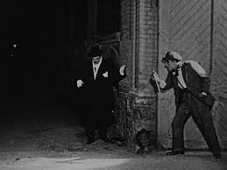
Dramatic Irony:
When the audience knows something that the characters do not.
Example:
Horror movies are notorious for using dramatic irony. The audience knows that the murderer is behind the door or around the corner even when the victim does not.

