Slide 1
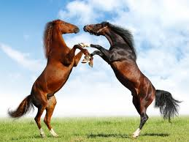
Hold your horses!
Cite your sources!

Slide 2
The importance of citing sources
Gives credit to the original author
Shows the writer/researcher used authentic sources
It’s the law!

Slide 3
The many types of citations
MLA (Modern Language Association)
Widely used in middle and high schools, and with some collegiate research; mainly used in humanities (Language Arts and Social Studies)
APA (American Psychological Association)
Used mainly in collegiate settings, particularly in social science, education and psychology research
Chicago (footnote style)
More flexible, footnote style, widely used for history
(Yale College Writing Center)

Slide 4
What should we use?
MLA!!!

Slide 5
WHEN SHOULD WE USE MLA?
For now, we will get into the practice of using MLA with our novels. When you refer to the story, use a direct quote, and/or paraphrase from the novel, you will need to follow the proper MLA format.
Later on in the year, will write a formal research paper. For this paper, you will be asked to use a variety of sources and cite them all within the paper and with a Bibliography.
A Biliogro-what?! Don’t worry- we will learn what that is later. ☺

Slide 6
HOW DO WE USE MLA?
When writing a research paper and/or writing about a novel, you need to include what are called “in-text citations.” This means, within your sentence or paragraph, you acknowledge the author whom you are quoting and/or paraphrasing.
For MLA, in-text citations for most sources follow this format:
(Author’s last name, page #)
Ex: (Collins, 17)
NOTE: If you refer to the same source within the same paragraph (or the entire paper, you only need to cite their name once, then just the page number).
EX. The author of The Hunger Games created a whole new world called Panem (Collins, 4). In the first chapter, she describes the different Districts with great detail (3-20).

Slide 7
CITING DIRECT QUOTES and paraphrases
For direct quotes, use this format:
One of the most memorable lines repeated throughout the novel begins with Effie Trinkett when she declares, “Happy Hunger Games! And may the odds be ever in your favor” (Collins, 19).
For indirect quotes, use this format:
Katniss’ 12-year old sister’s name was called to be one of the Tributes (Collins, 18).

Slide 8
Bibliography (aka works cited page)
When you use sources other than your own brain in your writing, you not only need to include in-text citations but a works cited page as well.
This page is a list of every source you included in your paper, even if you only referred to one word from the author’s writing.
Works cited pages must be:
In ABC order
Follow a specific format
Include every source in your paper

Slide 9
Works cited page rules
Basic Rules
Begin your Works Cited page on a separate page at the end of your research paper. It should have the same one-inch margins and last name, page number header as the rest of your paper.
Label the page Works Cited (do not italicize the words Works Cited or put them in quotation marks) and center the words Works Cited at the top of the page.
Double space all citations, but do not skip spaces between entries.
Indent the second and subsequent lines of citations five spaces so that you create a hanging indent.
List page numbers of sources efficiently, when needed. If you refer to a journal article that appeared on pages 225 through 250, list the page numbers on your Works Cited page as 225-50.
(http://owl.english.purdue.edu/owl/resource/747/05/)

Slide 10
Format for works cited sources
Format:
Lastname, Firstname. Title of Book. City of Publication: Publisher, Year of
Publication. Medium of Publication.
Ex:
Collins, Suzanne. The Hunger Games. New York: Scholastic Inc., 2008. Book.

Slide 11
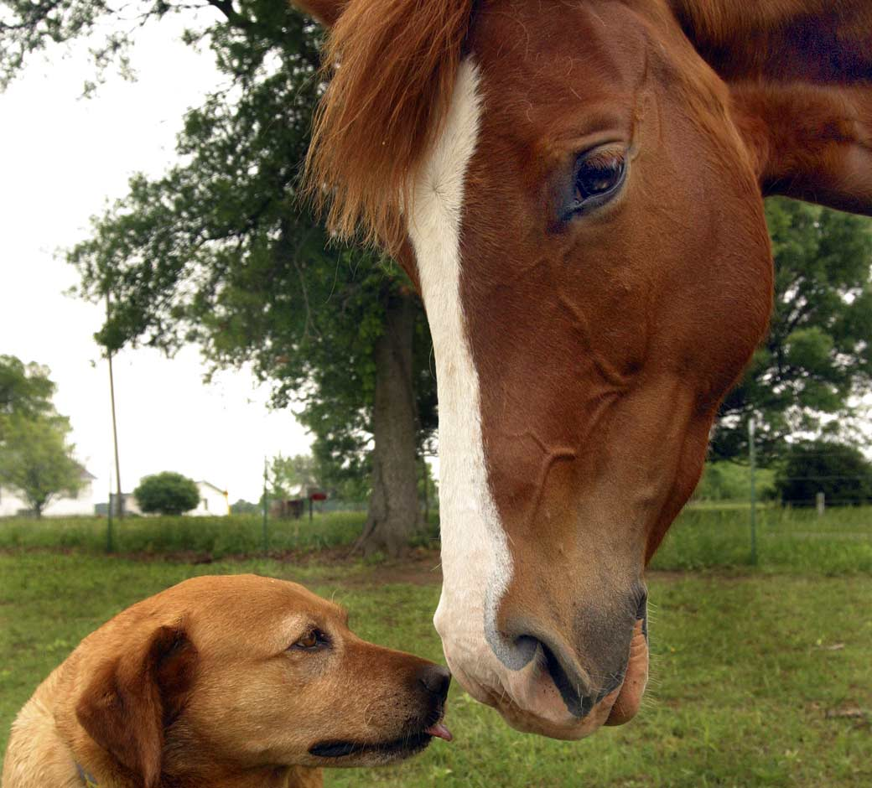
What about non-books?
For more information, formats and examples, use reference books such as Write Source, and online resources such as the Purdue Owl, EasyBib, Citation Machine and many others.
Well done, Young Jedi.
Thank you, Yoda.

